Slide 1
Video Inpainting
B04902040 王郁婷 B04902103 蔡昀達

Slide 2
Problem Definition
To remove unwanted text or object in a video
The goal is to make it look like the text / object never exists

Slide 3
Challenge
Large object inpainting
Texture & structure restoration
Motion consistency

Slide 4
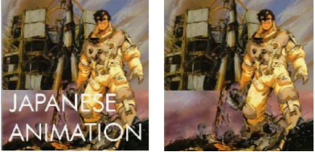


Region Filling and Object Removal by Exemplar-Based Image Inpainting
A. Criminisi, P. Perez, and K. Toyama
IEEE Transactions on Image Processing, vol. 13, no. 9, sep 2004

Slide 5
Exemplar-Based Video Inpainting Approach Using Temporal Relationship of Consecutive Frames
Kuo-Lung Hung , Shih-che Lai
2017 IEEE 8th International Conference on Awareness Science and Technology (iCAST 2017)

Slide 6
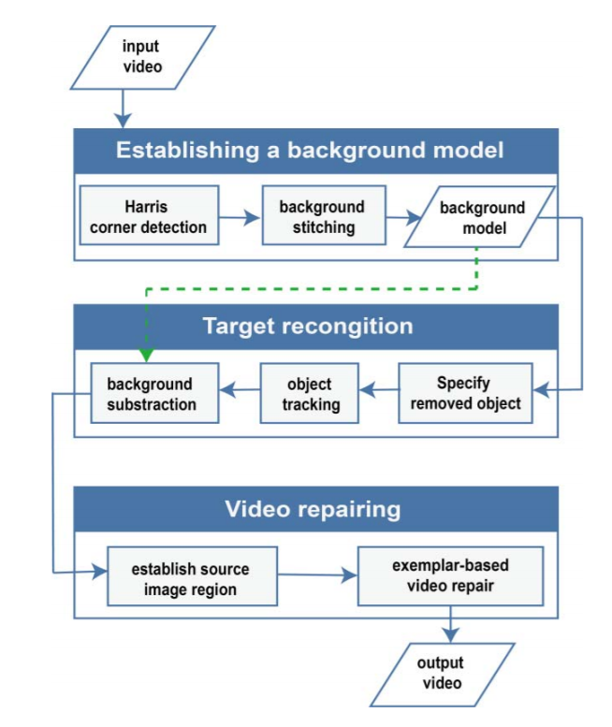
System
Architecture Diagram

Slide 7
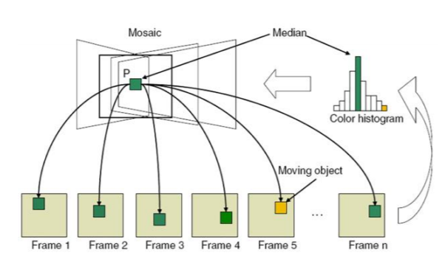
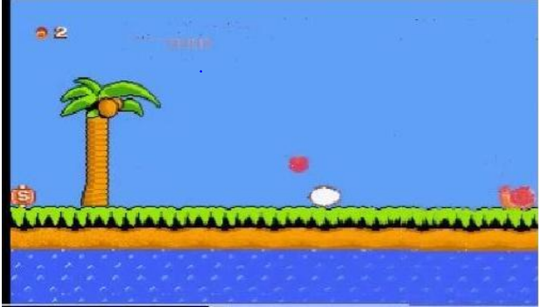
Background Stitching
Establishing a Background Model
Target Recognition
Video Repairing
using affine transformation and median filter method

Slide 8
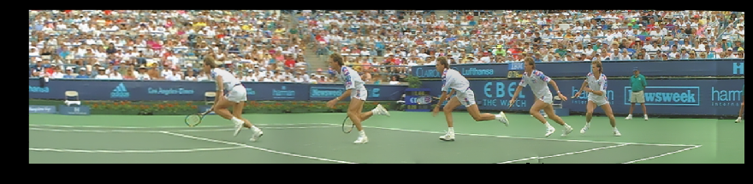
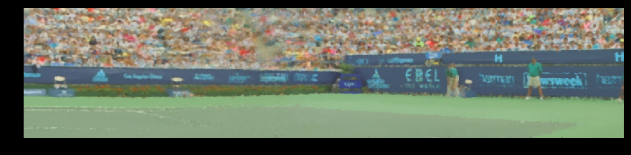

Slide 9
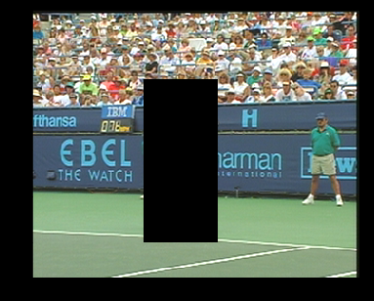

Slide 10
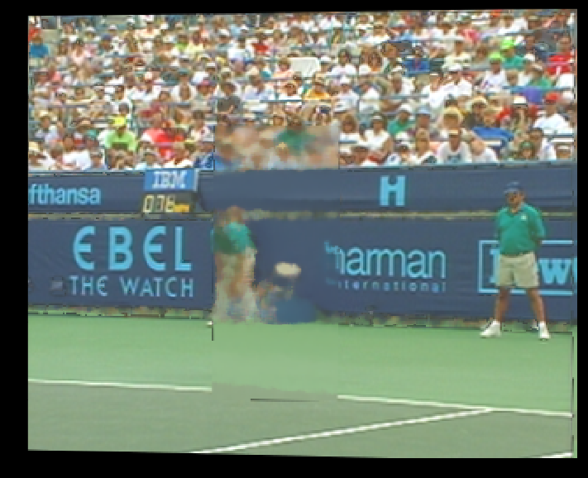
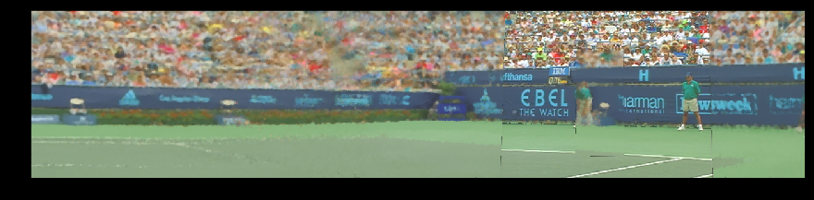

Slide 11
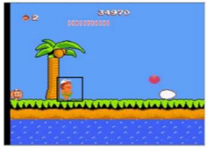
Specify Removed Object
Establishing a Background Model
Target Recognition
Video Repairing
specify a bounding box around an object for removal in the first frame the object appeared

Slide 12
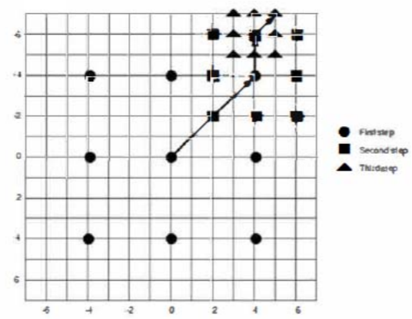
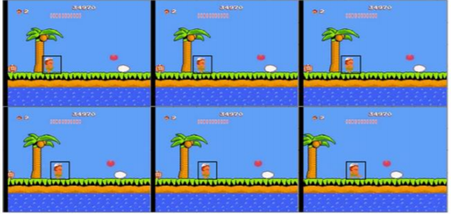
Object Tracking
Establishing a Background Model
Target Recognition
Video Repairing
use the three-step search (TSS) for object tracking

Slide 13
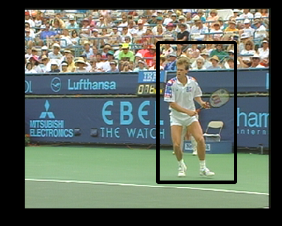
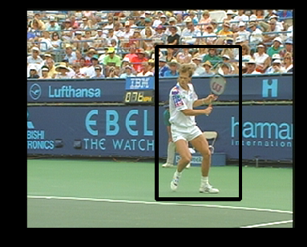
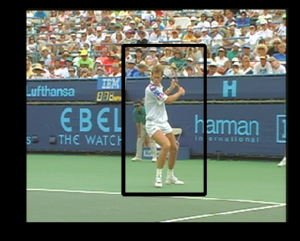

Slide 14
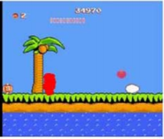
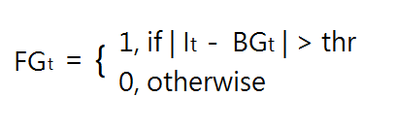
Background Subtraction
Establishing a Background Model
Target Recognition
Video Repairing
take the absolute to the difference between dynamic background model denoted as BGt and the frame It
then use a threshold to determine a pixel in the frame is belong to foreground or background
Notes:
Frame after removal of specified object

Slide 15
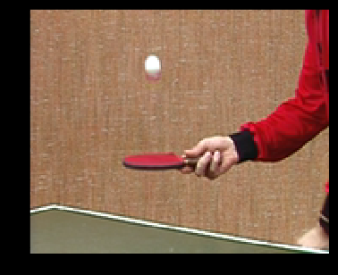
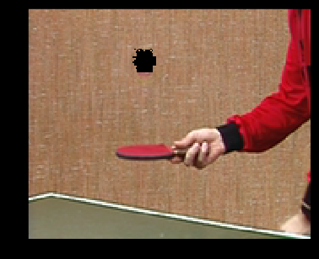

Slide 16
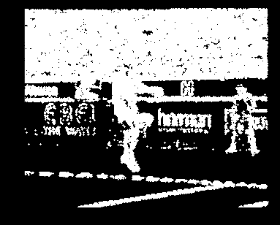
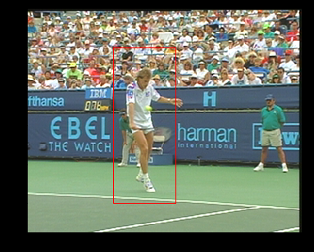

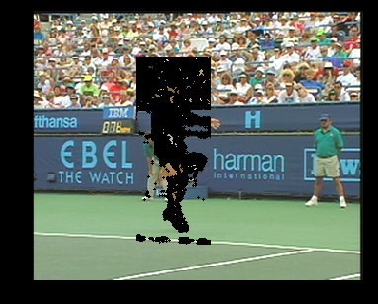

Slide 17
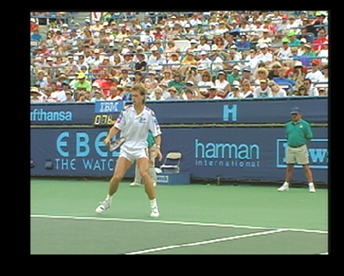
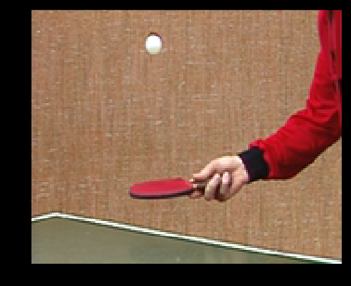
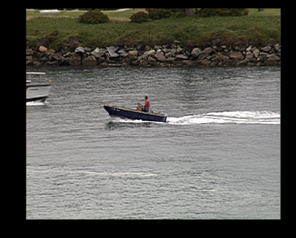
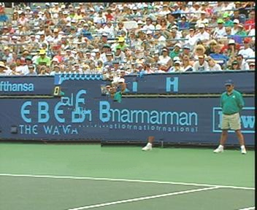



Slide 18
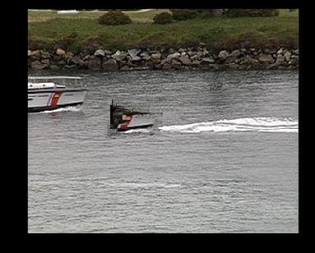
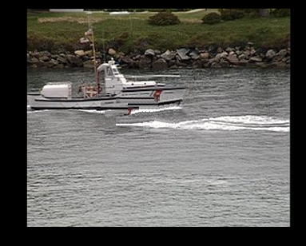
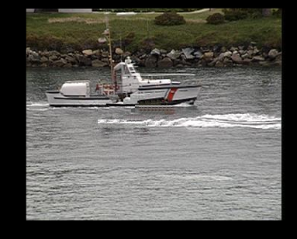

Slide 19
Experimental results

Slide 20
Discussions
盡量縮小inpainting的區域大小
-- 要找到方法能夠準確的區分前景和背景
Exemplar-Based 很花時間

Slide 21
References
A. Criminisi, P. Perez, and K. Toyama (2004), "Region filling and object removal by exemplar-based image inpainting," IEEE Transactions on Image Processing, Vol. 13, No. 9, pp. 1200-1212
Kuo-Lung Huang, Shih-che Lai (2017), “Exemplar-based video inpainting approach using temporal relationship of consecutive frames,” IEEE 8th International Conference on Awareness Science and Technology (iCAST)

